Slide 1

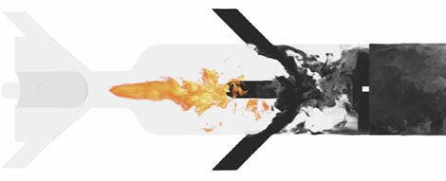
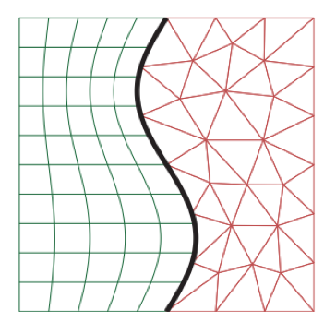
Preliminary Exam – Proposal Outline (December 2020)
Cory Mikida (AE)
Prof. Daniel Bodony (AE)
Prof. Andreas Klockner (CS)

Slide 2
Goals for This Outline
Describe the two focus topics for the prelim proposal
Establish both the goals and the bounds of the problem(s)
“Must-haves” and “nice-to-haves”
Lay out a plan for accomplishing these goals, for now in minimal detail
State the current status of each project
Ablation test (VKI)

Slide 3
Time Integration of Reacting Flows

Slide 4
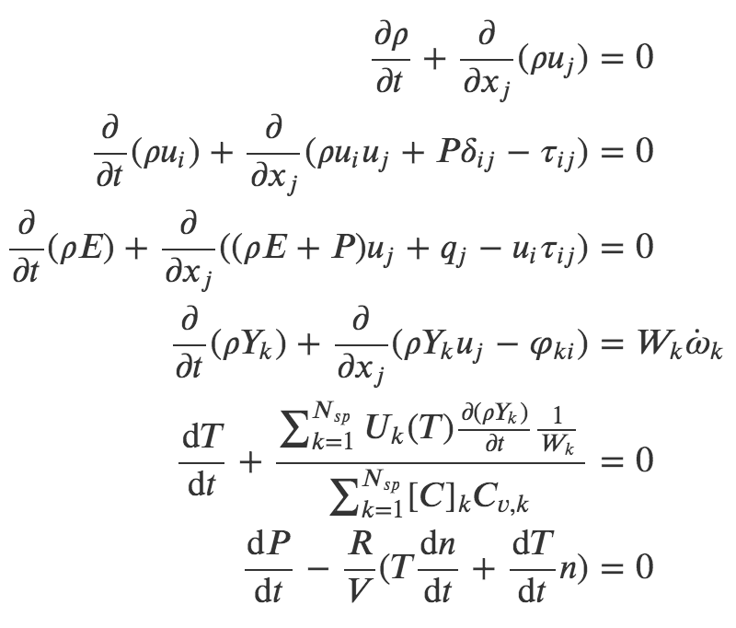
The Topic/Problem
The mission statement: develop stable, accurate, and efficient multi-rate time integration schemes for reacting flows
Chemical source terms in governing equations tend to be stiff, setting the limiting timestep to be oppressively low relative to the fluid motion or requiring implicit treatment
As with disparate overset mesh sizes, this presents an opportunity for multi-rate to save the day
Species production rates (stiff)
Ablation test (VKI)

Slide 5
Goals and Bounds
Must-have: demonstrate a novel scheme (adaptive implicit-explicit multi-rate) driving a canonical or demonstrative reacting flow problem (more) correctly and (more) efficiently
Monitor and maintain presence of solution on constraint manifold (ideal gas law)
Nice-to-have: report on and/or optimize time integration within design space presented by adaptivity choices (see next slide)
Nice-to-have: demonstrate tangible improvement over CVODE (state of the art) in at least one metric
Beyond our bounds: multivariable solves incurred by certain situations (multiple coupled implicit RHSs, IMEX LTE)
Ablation test (VKI)

Slide 6
The Plan
Implement multi-rate Adams integrators (established as a viable vehicle for performance improvement by [1])
Add ability to integrate chemistry implicitly, and at a different timestep than that of the fluid motion
Coupling the chemistry with the fluid RHS will elevate temporal accuracy beyond that of the previous splitting approach (first order)
Timestep adaptivity also identified as critical need in early testing – add this capability to multi-rate Adams integration using local error estimates as with ODE45/CVODE
This latter capability also introduces a number of design choices worth exploring
Timestep adaptivity versus step ratio adaptivity
Track local error/make adaptivity decisions based on subset of solution components?

Slide 7
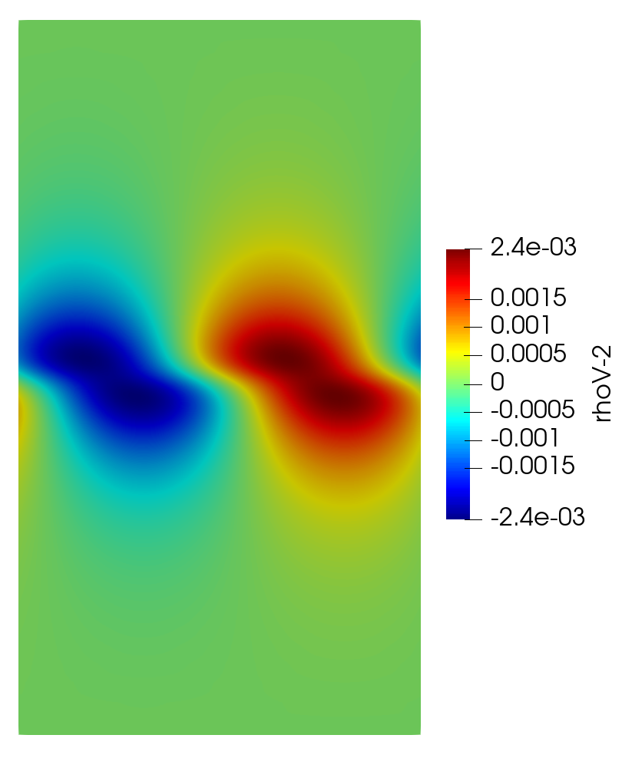
The Plan (cont’d)
Software: PlasCom2 (fluid solver), Leap/Dagrt (code generation for integrators), PyJac-V2 (code generation for chemical kinetic Jacobians)
Application: demonstrative reacting mixing layer problem
Hyperbolic tangent velocity profile as baseflow ([2], [3])
San Diego 9-species chemical mechanism
Initial condition: introduce temperature variation to localize autoignition to the mixing layer

Slide 8
Current Status
Leap RK IMEX integration built into PlasCom2, using PyJac-generated chemical Jacobian for implicit solve
PyJac modified to include NASA9 thermodynamic polynomials (useful/required for maintaining accuracy for ignition problems with large temperature ranges)
Adams-Moulton integrators implemented as baseline for implicit treatment of chemistry in multi-rate Adams
Error-informed timestep adaptivity incorporated into single-rate and multi-rate Adams integrators
Local error estimate formed using explicit methods of differing orders
Implicit-explicit multi-rate w/adaptivity in development
Test problem(s) in development
Mixing layer (demonstrative case)
One-dimensional laminar flame (baseline case?)
Ablation test (VKI)

Slide 9
Energy-Stable Hybrid Spatial Discretizations

Slide 10
The Topic/Problem
The mission statement: create a stable and accurate interface between structured (SBP) and unstructured (DG) spatial discretizations
Introducing localized regions of unstructured meshing allows for superior meshing of complex geometries
Starting point: nonconforming interface method of Kozdon and Wilcox ([4])
Boundary between spatial schemes traversed via projection of solution into “glue grid” polynomial space
Choice of polynomial space in glue grid/structure of projection operators can allow for proof of energy stability
However, resulting projection stencils give an underdetermined system, with optimization used to produce final projection operators
Ablation test (VKI)

Slide 11
Goals and Bounds
Must-have: stable, accurate, and *unisolvent* approach to interior projection from structured (SBP) to unstructured (DG) meshes in 2D
Apply this to a periodic problem as a baseline proof-of-concept
Nice-to-have: application to 3D problems
Nice-to-have but based on our current experience will be tricky: stable, accurate, and unisolvent boundary projection
Boundary stencils are currently what make the whole-operator solves of Kozdon and Wilcox underdetermined
Ablation test (VKI)

Slide 12
The Plan
Starting point: remove more complicated boundary treatment from setup, construct interior-only periodic projection operators
Be able to write down proof of stability (via energy) - this may result in a different operator condition than K+W’s compatibility, and may require a more thorough search for all possible operator conditions than has yet been performed
Establish a sensible set of DOFs
Solve for these operators from a square system based on accuracy conditions for projection in *both* directions (grid-to-glue, glue-to-grid), in addition to any constraints we need to impose to ensure stability (based on conditions mentioned above)
Prove the efficacy of these projection operators in 2D
Apply lessons learned to boundary treatment
Ablation test (VKI)

Slide 13
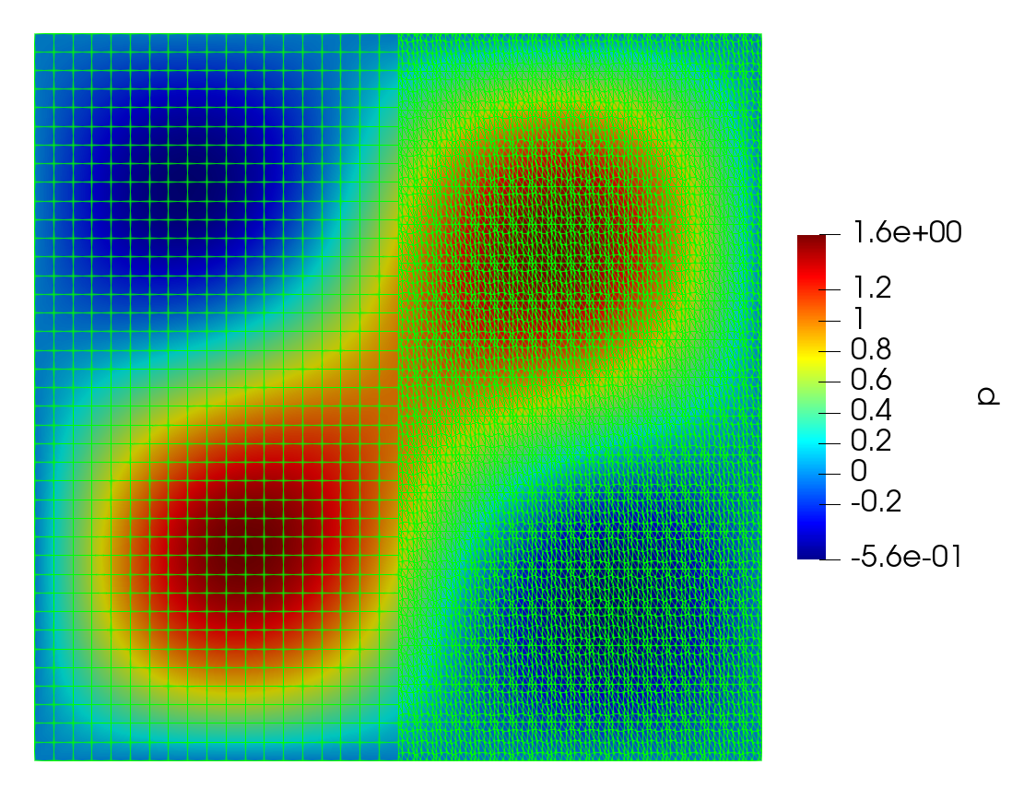
The Plan (cont’d)
Software: Grudge (w/meshmode and other tools, for DG discretization), Leap/Dagrt (for time integration)
Application: 2D acoustic wave equation on split domain
Ablation test (VKI)

Slide 14
Current Status
Python-based testing setup created which implements split-domain 2D acoustic wave problem described on the previous slide
Matlab and Maxima codes written with the goal of experimenting with different DOF/constraint setups to produce a unisolvent and stable interior projection operator
Needed: firmer understanding of how compatibility condition of K+W fulfills interior projection operator accuracy constraints in both directions (pencil and paper)
Ablation test (VKI)

Slide 15
References
[1] Mikida, Cory, Andreas Klöckner, and Daniel Bodony. "Multi-rate time integration on overset meshes." Journal of Computational Physics 396 (2019): 325-346.
[2] Michalke, Alfons. "On the inviscid instability of the hyperbolictangent velocity profile." Journal of Fluid Mechanics 19.4 (1964): 543-556.
[3] Blumen, William. "Shear layer instability of an inviscid compressible fluid." Journal of Fluid Mechanics 40.4 (1970): 769-781.
[4] Kozdon, Jeremy E., and Lucas C. Wilcox. "Stable coupling of nonconforming, high-order finite difference methods." SIAM Journal on Scientific Computing 38.2 (2016): A923-A952.
Ablation test (VKI)

